Slide 1
SharePoint 2010
From a consultant’s point of view
Henry Ong
Senior SharePoint Specialist
6th Street Consulting
http://6sc.com

Slide 2
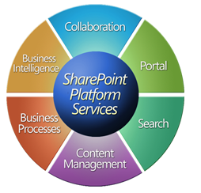
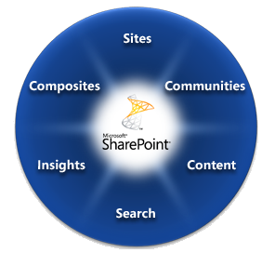
The old vs the new
Notes:
Looks kind of like a Picasso eh?
Communities: Empowering users to work in different ways with each other across organizations. Non-hierarchical.
Sites: Not only intranets – portals, team sites, extranets, public facing website, expand across all different environments
Content: Management of content through lifecycle of content. Make content come alive with easier discovery.
Search: Highly scalable, accurate search with FAST. Search not only content within SharePoint, but rich people and business data search across organizations and LOBs
Insights: Combining all features of SharePoint with BI to help you make more insightful decisions faster.
Composites: Rapidly make application mash-ups on top of the SharePoint platform by way of rich integration with companion products.

Slide 3
What’s new…
…for the Business and End Users?

Slide 4
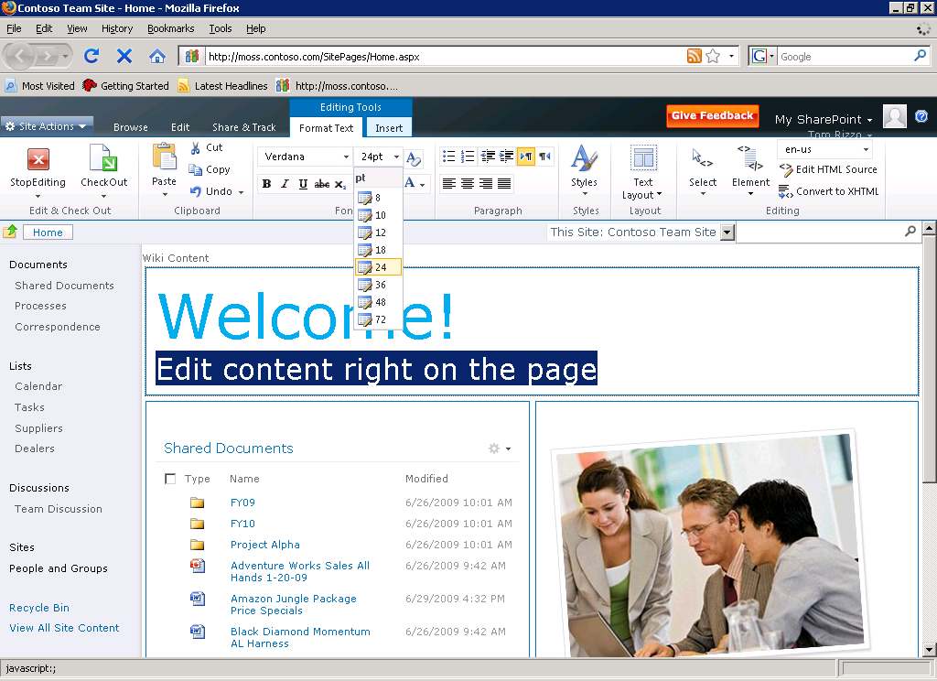
Enhanced User Interface
Contextual Ribbon!
Inline “Web Edit”
Upload and resize images from the browser!
Notes:
1. AJAX interface; More intuitive; Less training
2. Cross browser compatibility – Firefox, Safari, etc.

Slide 5
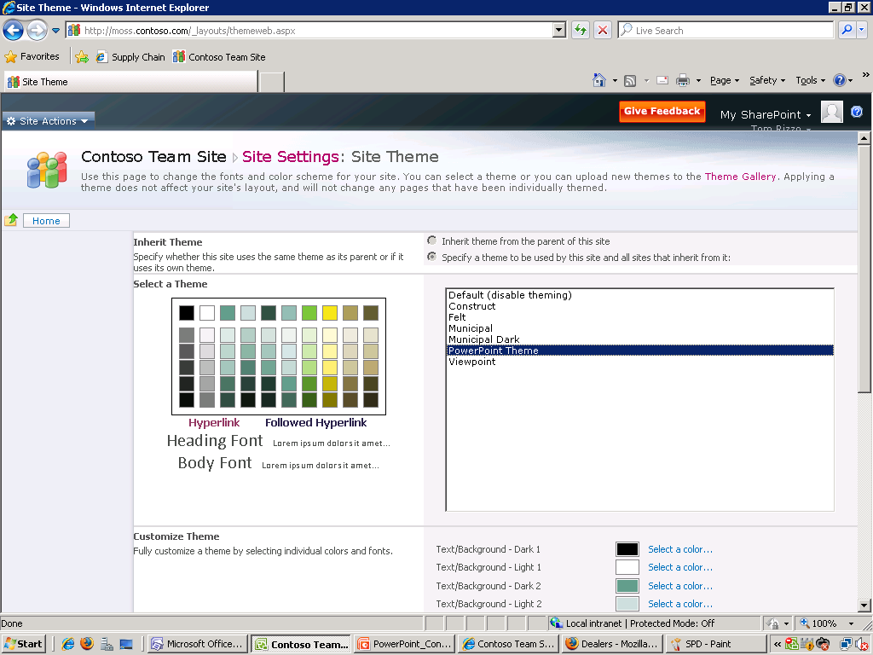
User Defined Themes
Import a theme generated from PowerPoint
Configurable color schemes
Notes:
1. No more developer time needed to create themes!

Slide 6
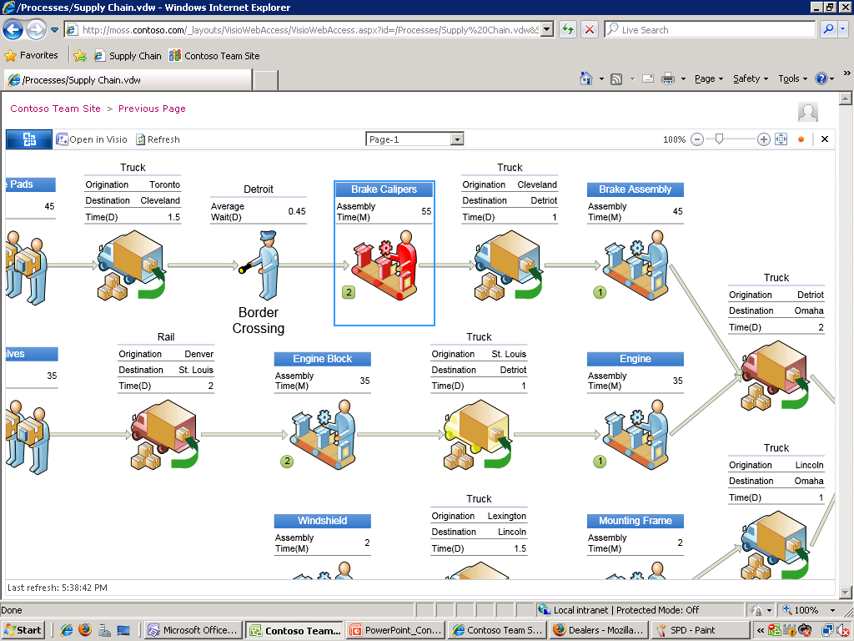
Visio Services
(Kind of like Excel Services!)

Slide 7
What’s new…
…for the IT Pros and Administrators?

Slide 8
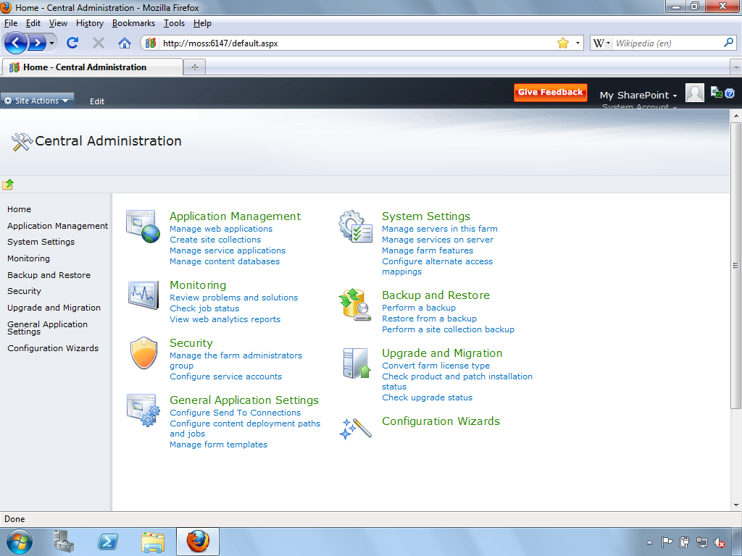

Improved Central Admin UI
Ribbon
Action
Server 2008
Style UI
Notes:
No more SSP?

Slide 9
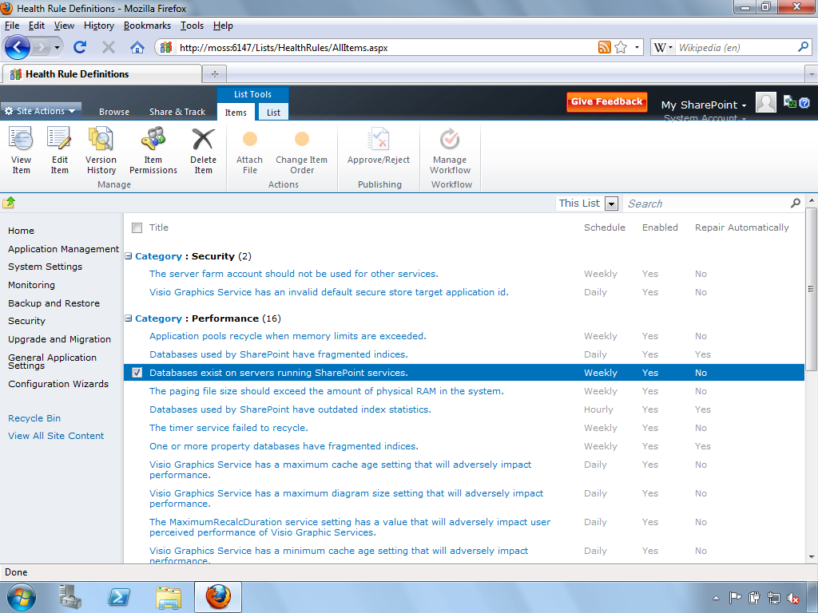
Best Practices Analyzer
Runs on a Timer Job with Configurable Rules
Repair Auto-magically?!
Notes:
Best Practice Analyzer runs on a timer job with configurable rules.

Slide 10
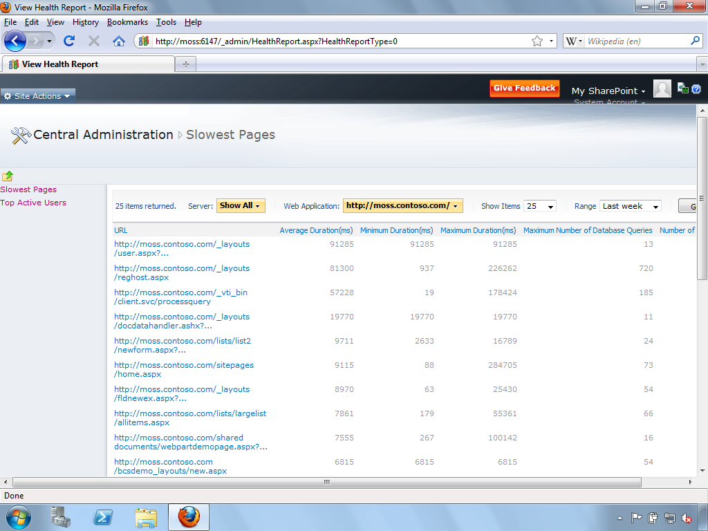
Logs & Reporting to the DB
Developers will have access to the DB Schema.
Notes:
All logs and usage reporting is now stored in a content database instead of on the file system. Gives developers the flexibility to extend and create prettier reports.

Slide 11
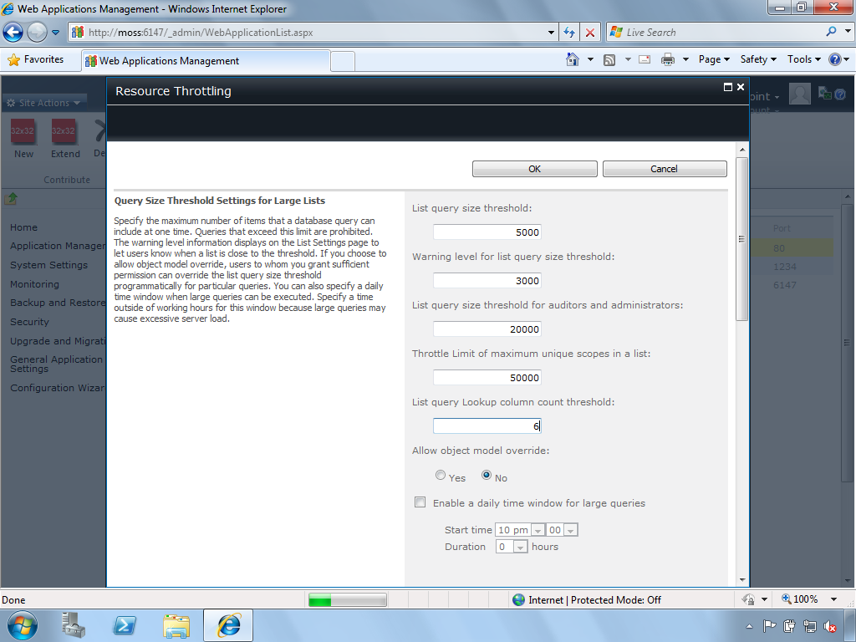
Large List Throttling
No more 2000 item limit voodoo talk!
Configurable List Throttling
And Thresholds
List throttling controls forces end users to create more efficient views with < x number of items.
Notes:
Doing away with the 2000 recommendations and leaving it up to the server admins to throttle as needed. Probably b/c of improved handling of queries, AJAX, and 64-bit server requirements.
List throttling controls forces end users to create more efficient views with < x number of items. Better manage system resources.

Slide 12
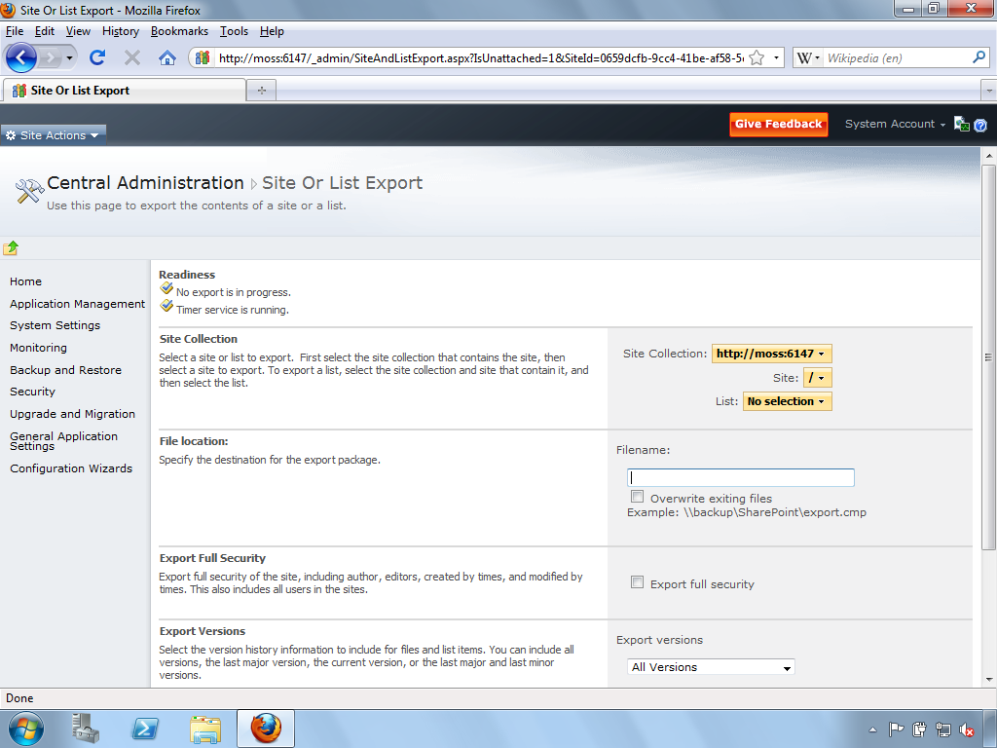
Granular Backup/Restore Options
Notes:
Backup and Restore options are more flexible
Granular data recovery
Recover from unattached content DB (Don’t need to restore an entire content DB to get just one document or list item back)
Uses the Content Deployment API (I think).

Slide 13
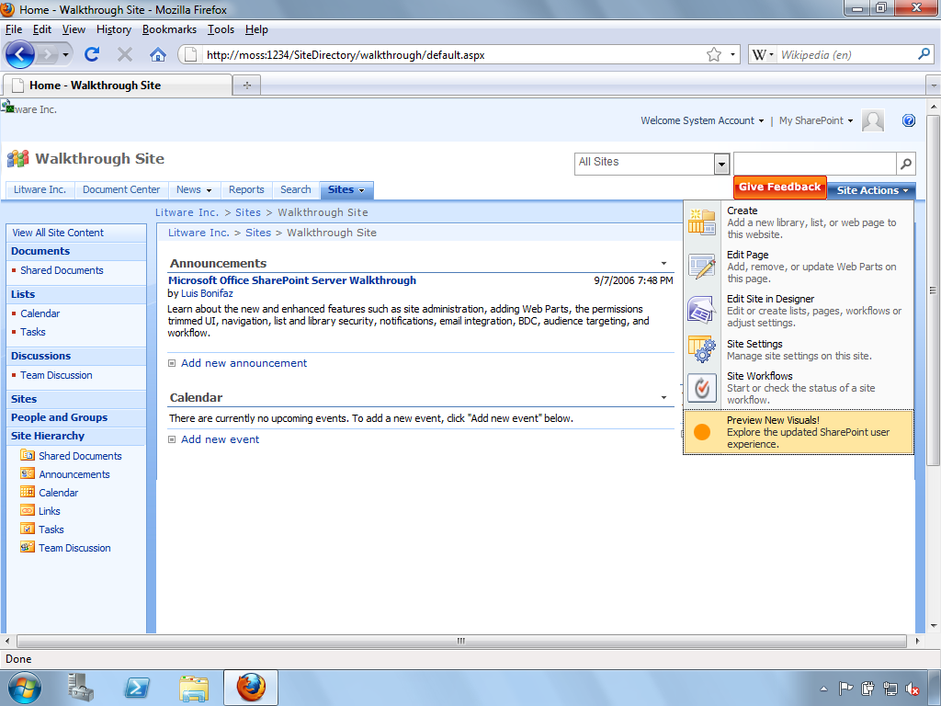
Less Abrasive Upgrade Process
Enables compatibility check before committing.
Notes:
1. Upgrade is more flexible – let’s you upgrade one site at a time.
2. Doesn’t force upgrade of the MOSS 2007 user experience/look and feel/branding.
3. Can preview before committing upgrade.

Slide 14
What’s new…
…for the Developers?

Slide 15
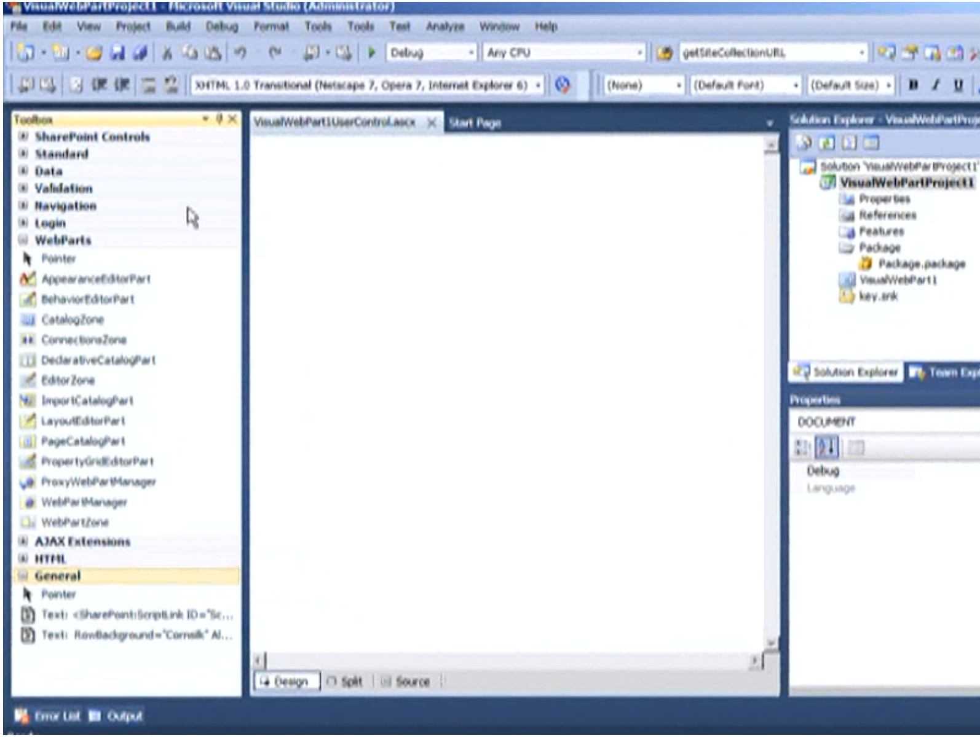
Visual Web Part Development!
Drag and drop your web part controls here.
Shortens development cycle.
Notes:
1. Visual Web Part designer
2. Better support with automated builds via TFS
3. Visual Studio 2010 has SharePoint project types built-in (hopefully better than Visual Studio Extension Kits for SharePoint)
4. WSP Designer
5. Connect to SharePoint Artifacts via Visual Studio Server Explorer (ala SharePoint Manager 2007)
6. Deployment Configuration Wizard (Add Solution, Deploy Feature, Activate Feature)

Slide 16
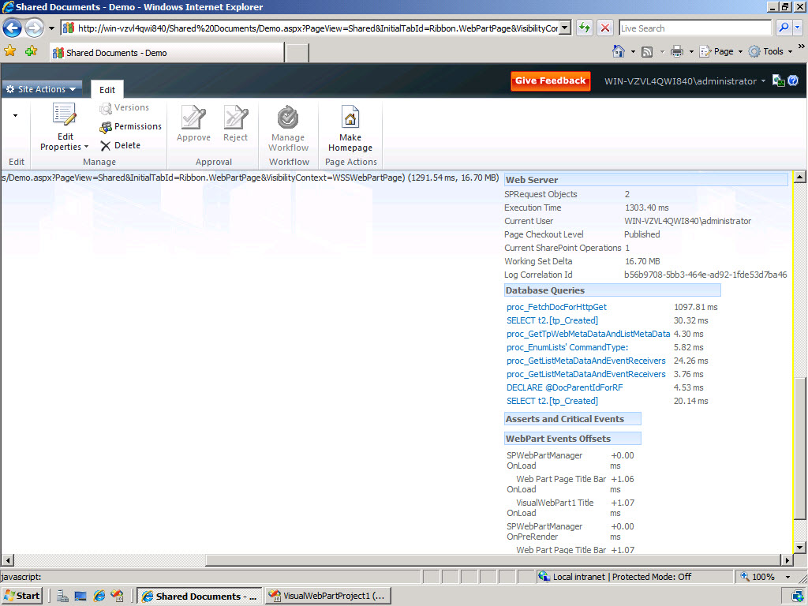
Web Part Performance Dashboards
Notes:
1. Developer Dashboard shows information about backend interactions caused by your code.
2. Provides diagnostic performance insight.

Slide 17
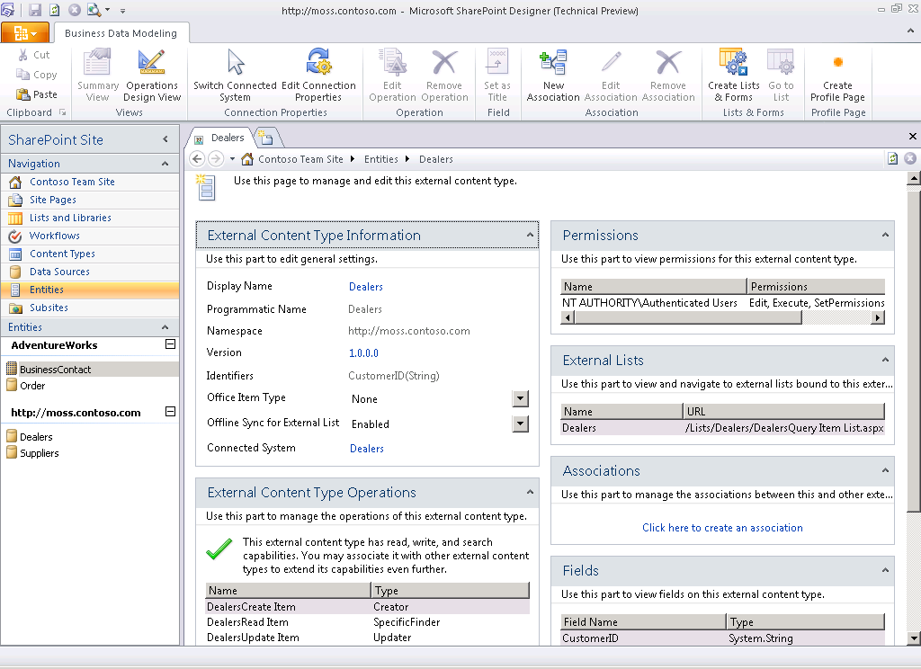
Lists to Front End LOB Data
Notes:
Not advertised as a dev/admin enhancement but how many end users would really do this kind of thing?
1. Integrate legacy databases with SPLists as the front end.
2. R/W capabilities with BCS.
3. Create External Content Type sources with Business Connectivity Services via SharePoint Designer

Slide 18
Other noteworthy changes
Combination of XML + Javascript Development & Features
Dedicated classes for working with Powershell
Use InfoPath to design List Forms
More information (SharePoint 2010 SDK Preview) - http://www.microsoft.com/downloads/details.aspx?FamilyID=94afe886-3b20-4bc9-9a0d-acd8cd232c24&displaylang=en

Slide 19
Upgrade Ready?
Things to do before you upgrade to SharePoint 2010

Slide 20
64-bit
Everything!

Slide 21
64-Bit Infrastructure
Windows Server 2008 x64
SQL Server 2005/2008 x64
Anything else?
Notes:
Note: Windows Server 2008 only!
Maybe Visual Studio 64-bit? Discuss.

Slide 22
PreUpgradeCheck Utility
Install WSSv3/MOSS 2007 SP2
Get it for Free! ☺
Notes:
Go into the demo.
It won’t tell you much if you’re running 32-bit servers. It’ll say FAIL!

Slide 23
Contact Information
Henry Ong
henry.ong@6sc.com
http://blog.henryong.com
http://twitter.com/henry_ong
http://facebook.com/henryo

